Slide 1

Results of our iCLIP analyses
Dr. Kathi Zarnack
Buchmann Institute for Molecular Life Sciences (BMLS)
Goethe University Frankfurt, Germany
NCCR / SIB Summer School

Slide 2
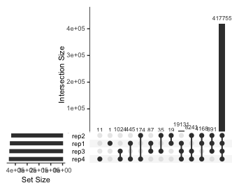
Reproducibility I

Slide 3
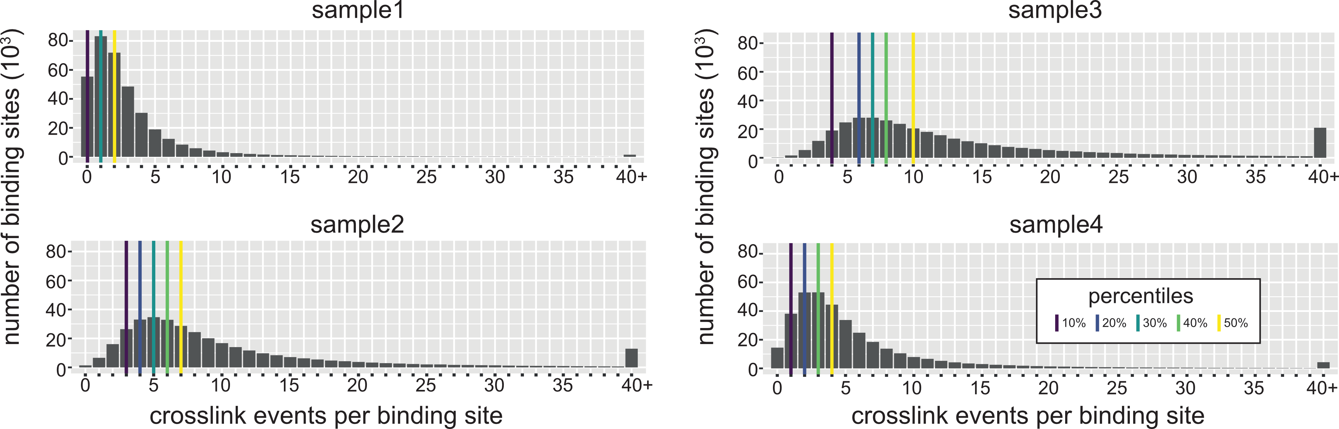
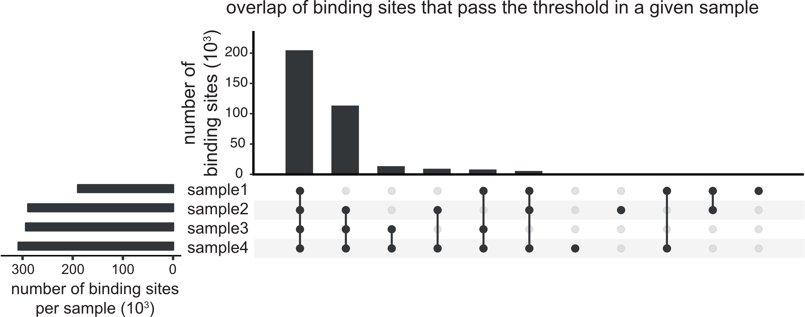
Reproducibility I

Slide 4
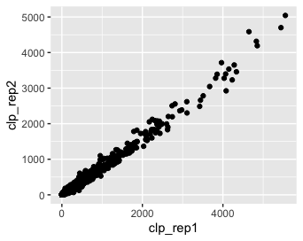
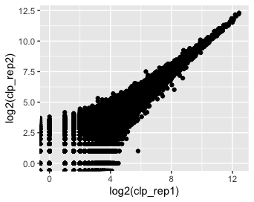
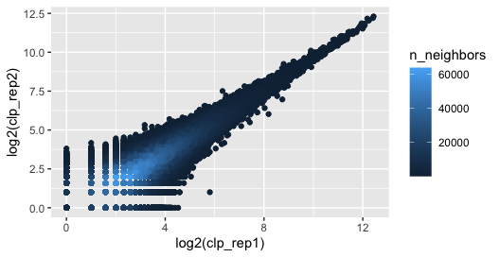
Reproducibility II

Slide 5
GGally (all-against-all)

Slide 6
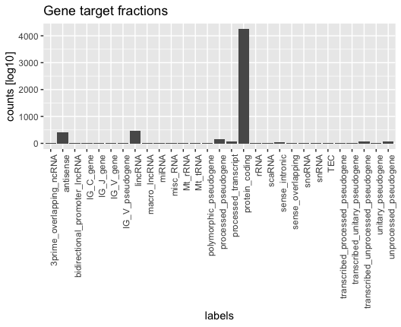
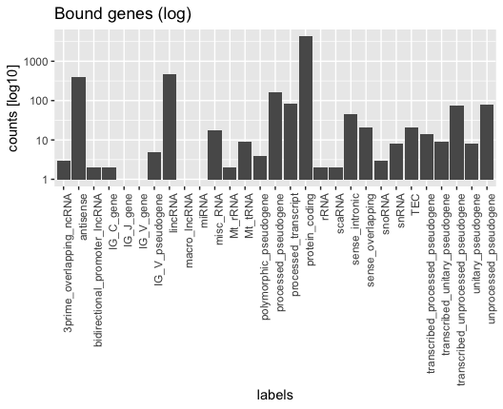
Plots

Slide 7
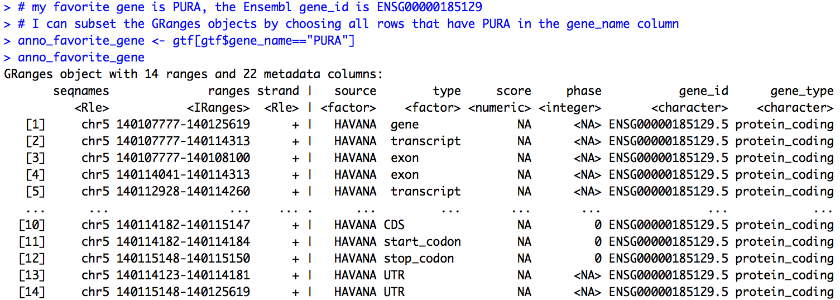
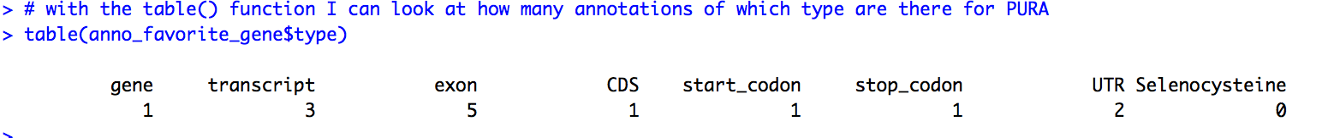
Assigning genes and transcript regions

Slide 8
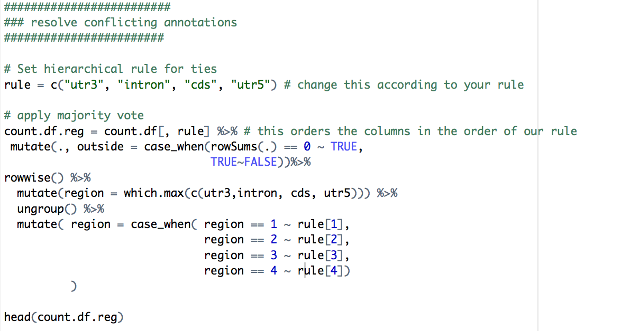
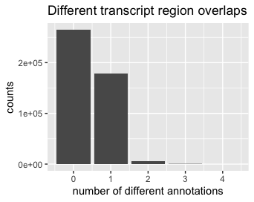
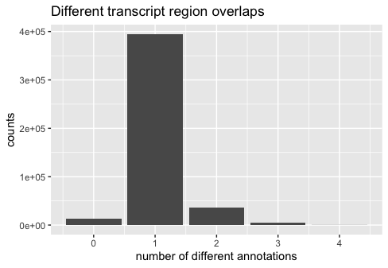
Conflicting annotations

Slide 9
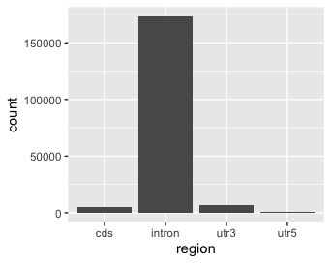
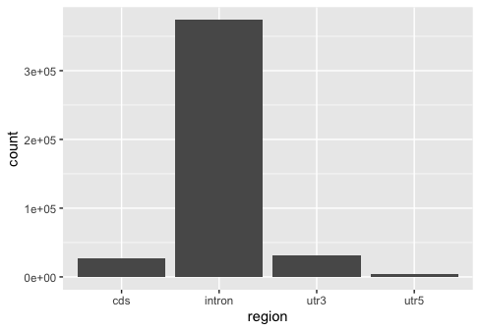
Resolved annotations

Slide 10
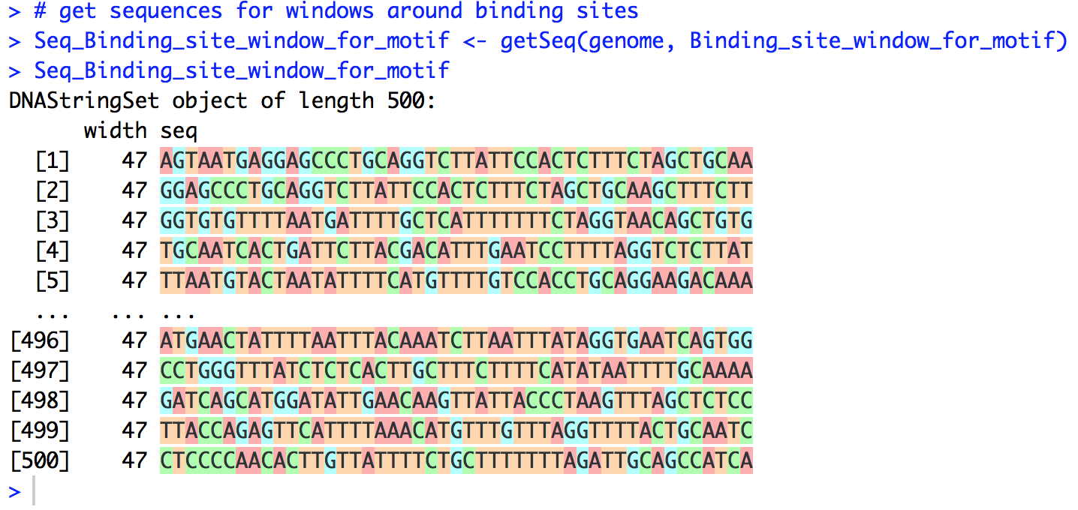
getSeq()

Slide 11
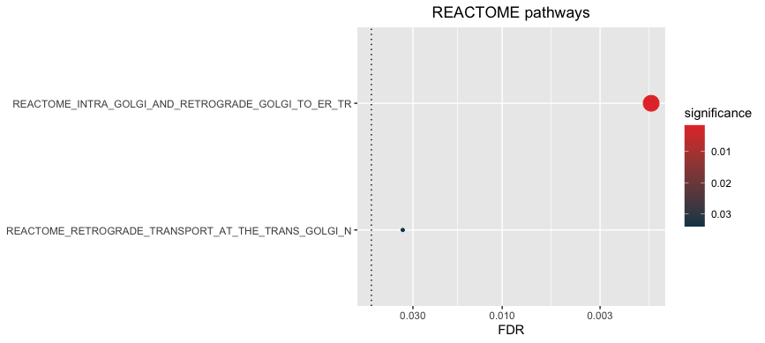
REACTOME pathway enrichment

Slide 12
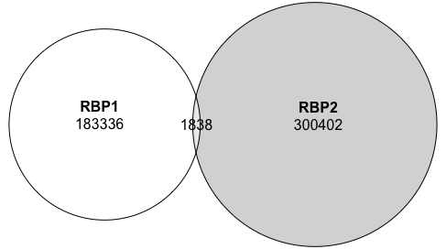
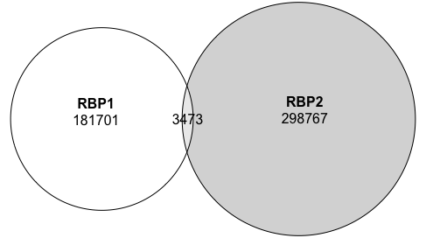
Overlap the binding sites of two RBPs

Slide 13
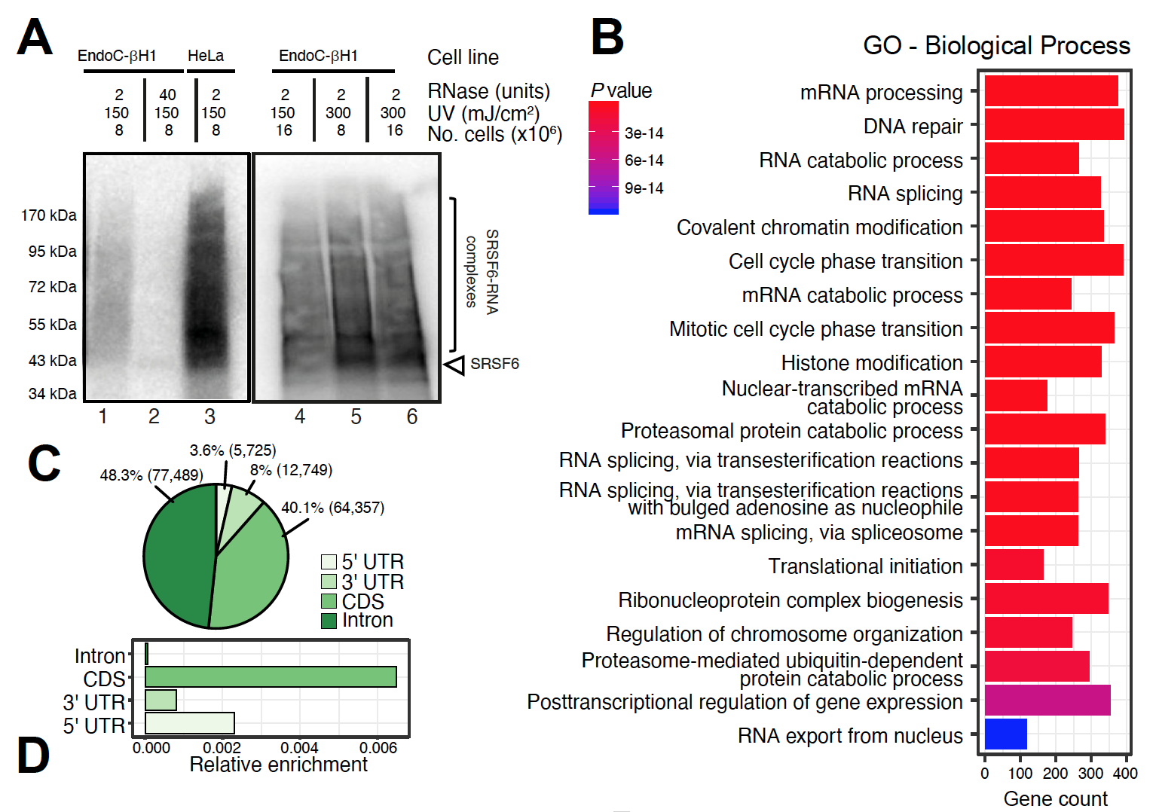
The binding specificity of SRSF6
Alvelos et al, unpublished

Slide 14
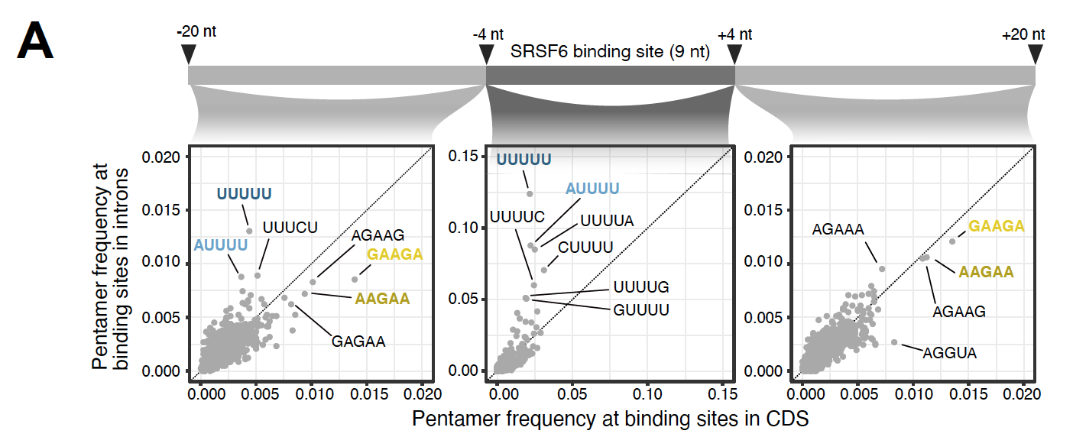
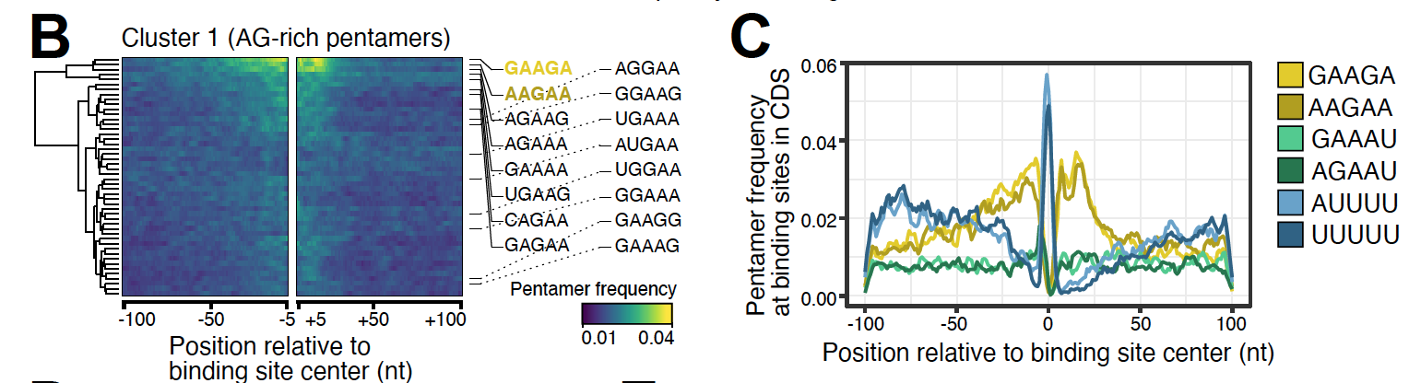
The binding specificity of SRSF6
Alvelos et al, unpublished

Slide 15
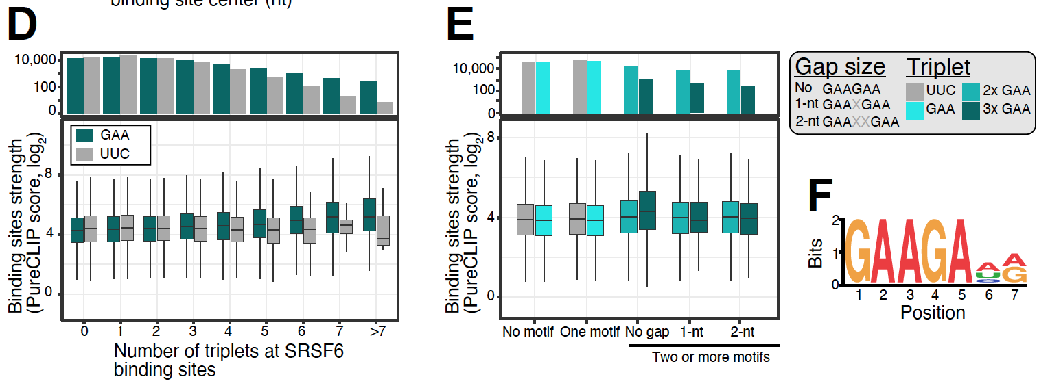
The binding specificity of SRSF6
Alvelos et al, unpublished

Slide 16
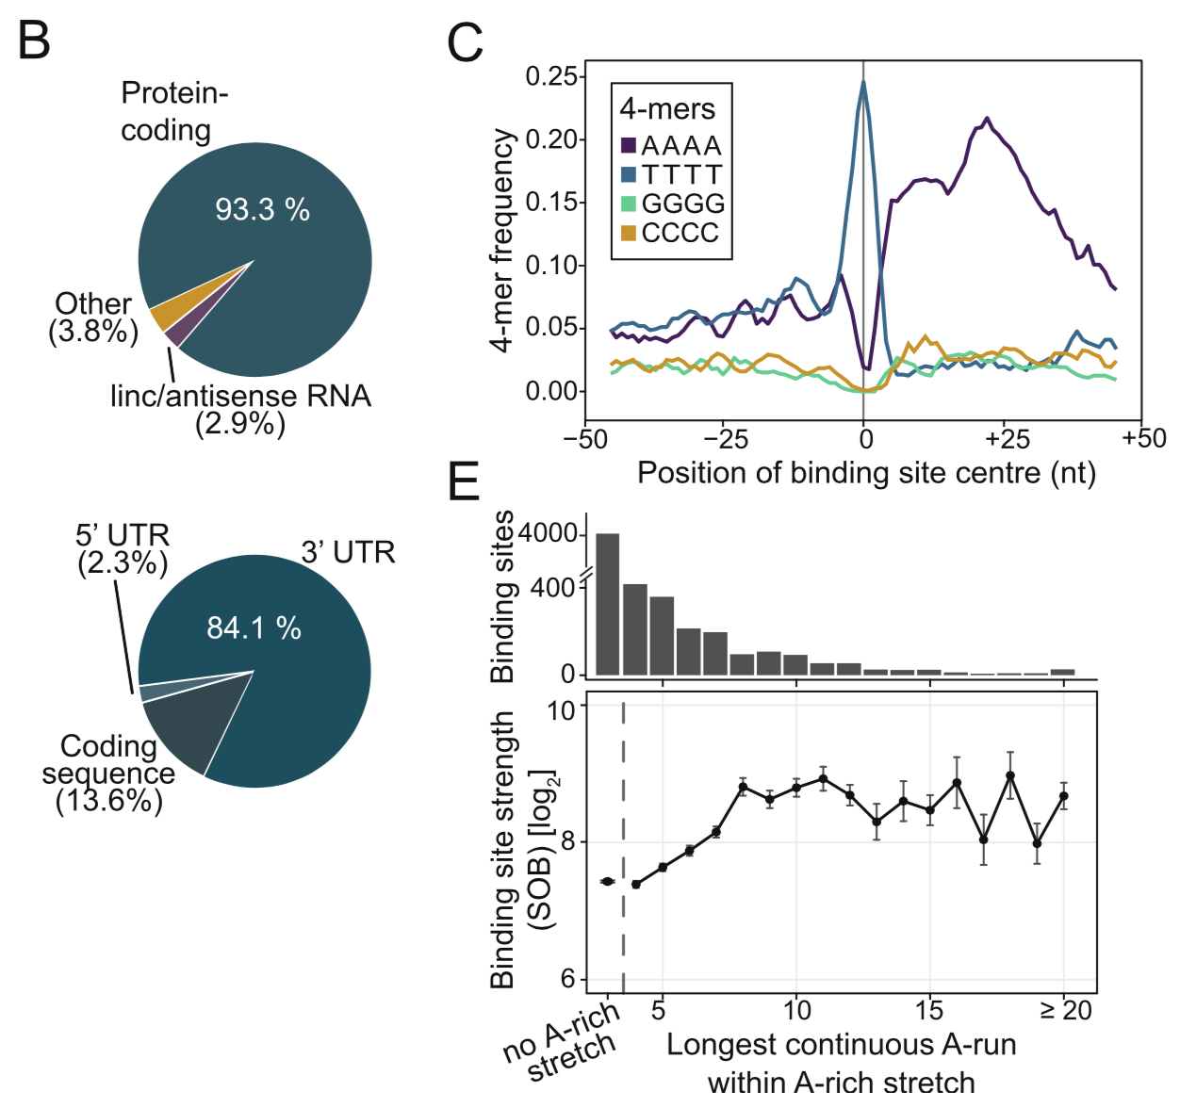
The binding specificity of MKRN1
Hildebrandt et al, Genome Biol, 2018

Slide 17
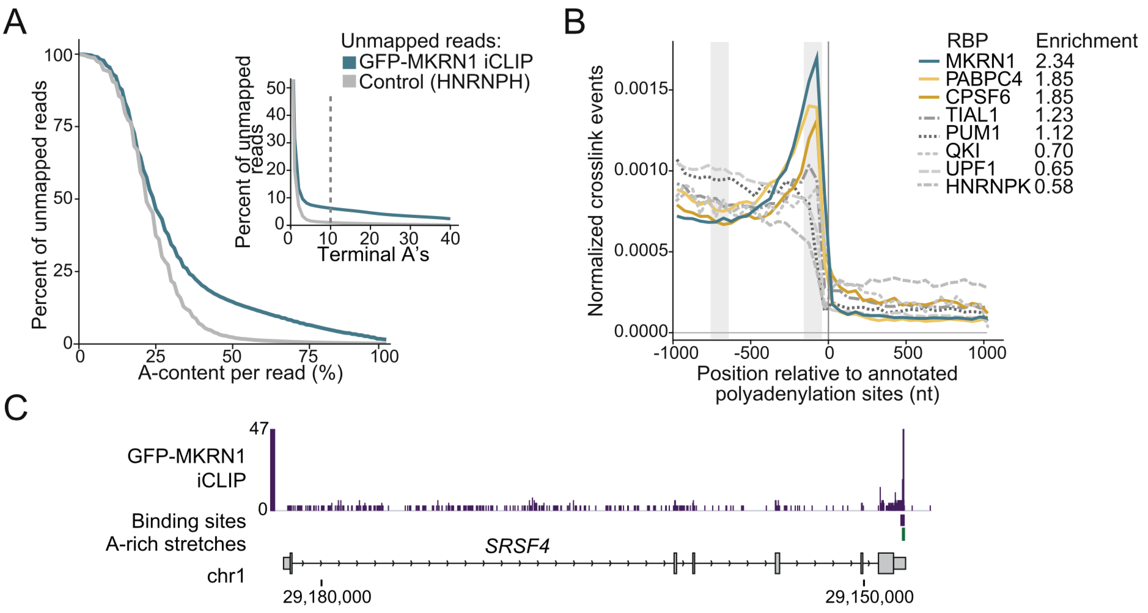
The binding specificity of MKRN1 (and PABPC4)
Hildebrandt et al, Genome Biol, 2018

Slide 18
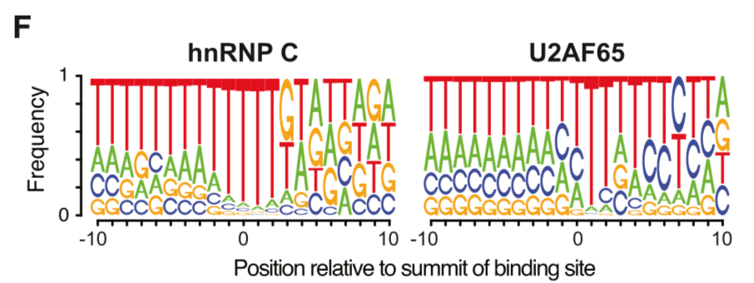
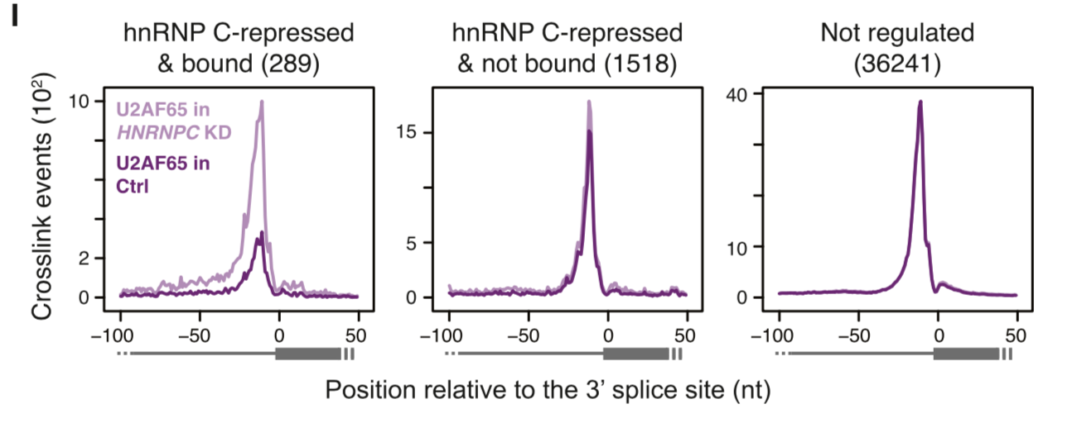
The binding specificity of U2AF65
Zarnack et al, Cell, 2013

Slide 19
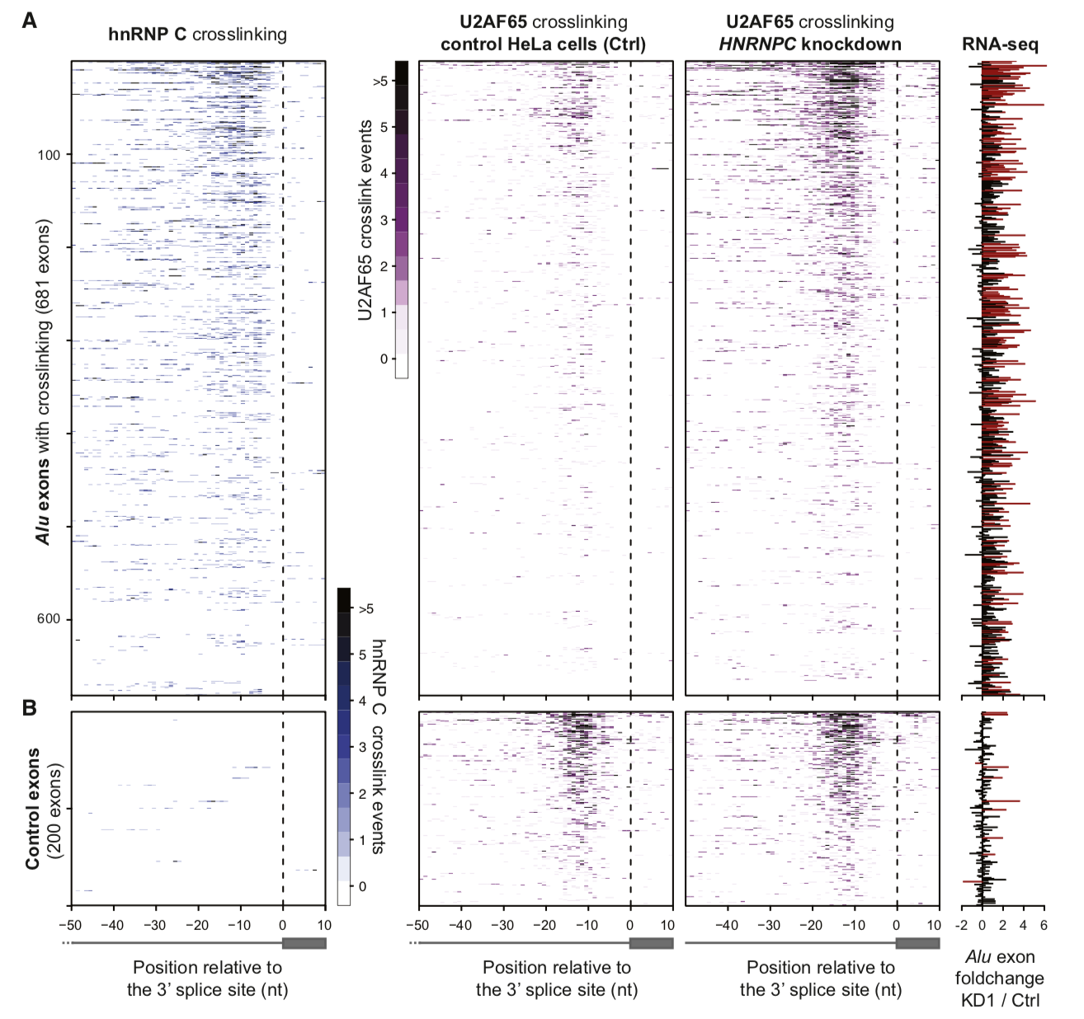
The binding specificity of U2AF65
Zarnack et al, Cell, 2013

